Slide 1
Topic - Electronic Interlocking Group EI-6
Submitted By :- Submitted To:
Anukalp kumar Mr. Salil Srivastava

Slide 2
Table of Contents
Introduction
Railway Signalling
Interlocking
Types of Interlocking
Electronic Interlocking
Terms Used in EI
Working of EI
Functioning of EI system
Requirements of EI system
Advantages Of EI
Status of Implementation

Slide 3
Introduction
Indian Railways (IR) is a statutory body under the ownership of the Ministry of Railways, Government of India that operates India's national railway system.
The first railway proposals for India were made in Madras in 1832.India's first railway line was named Red Hill Railroad and was built by Arthur Cotton to transport granite for road-building.
The headquarter of Indian Railway is situated in New Delhi.
In 1986, computerized ticketing and reservations were introduced in New Delhi

Slide 4
Railway Signaling
Signaling is essentially a sophisticated traffic light system for the railway.
A Railway signal is an electrical and mechanical device erected besides railway lines to pass information relating to the state of the line ahead of trains.
Signaling maintains safe distance between trains running in the same direction on a line.
It runs the trains at restricted speeds during repair work.

Slide 5
Interlocking
In railway signaling, an interlocking is an arrangement of signal apparatus that prevents conflicting movements through an arrangement of tracks such as junctions or crossings.
An interlocking is designed so that it is impossible to display a signal to proceed unless the route to be used is proven safe.
Interlocking is a safety measure designed to prevent signals and points/switches from being changed in an improper sequence.
Interlocking would prevent a signal from being changed to indicate a diverging route, unless the corresponding points/switches had been changed first.

Slide 6
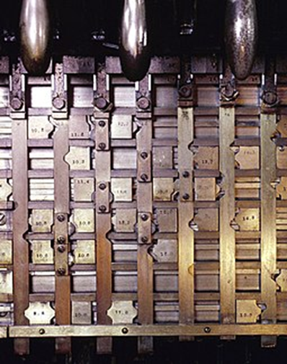
Types of Interlocking
Interlocking can be categorized as-
Mechanical interlocking -In mechanical interlocking plants, a lock bed is constructed, consisting of steel bars forming a grid. The levers that operate switches, derails, signals or other appliances are connected to the bars running in one direction. The bars are constructed so that if the function controlled by a given lever conflicts with that controlled by another lever, mechanical interference is set up in the cross locking between the two bars, in turn preventing the conflicting lever movement from being made.

Slide 7
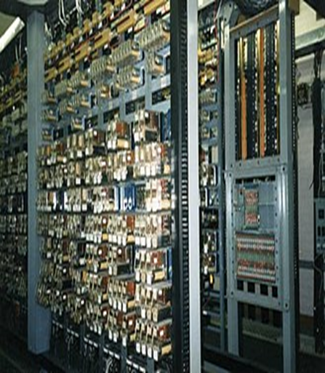
2. Relay Interlocking – It is the system used in large and busy stations that have to handle high volumes of train movements. In this, an entire route through the station can be selected and all the associated points and signals along the route can be set at once by a switch for receiving, holding dispatching trains. These interlocking are achieved through electrical switches known as Relays. These interlocking works on the principle of electromagnetism. In place of plungers or in addition to plungers, lever locks attached with levers.

Slide 8
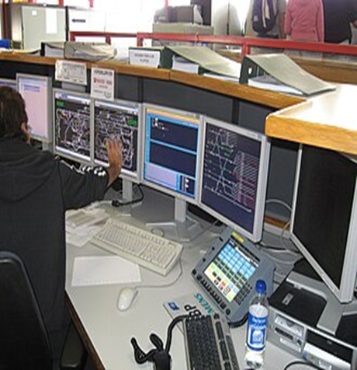
3. Electronic interlocking - Modern interlocking (those installed since the late 1980s are generally solid state, where the wired networks of relays are replaced by software logic running on special-purpose control hardware. The fact that the logic is implemented by software rather than hard-wired circuitry greatly facilitates the ability to make modifications when needed by reprogramming rather than rewiring.

Slide 9
Electronic Interlocking
Electronic Interlocking (EI) is the modern update to SSI.
It uses a fully software driven approach to setting routes, eliminating almost all relays, reducing complex wiring and interconnections etc.
Because it is software driven, diagnostics in case of failures are easier to identify.
Layout changes and remodeling don’t require a change in wiring, just updates in the software and output configurations.
IR has begun rolling out large EI at extremely busy stations like Kharagpur, Tundla, Jolarpettai, Hubli etc.
Panel interlocked stations due for upgrades are now being moved to EI.

Slide 10
The EI system consists of three crucial elements:
signals, track circuits, and point switches as-
Signals are used to communicate instructions to trains, indicating whether to stop (red), proceed (green), or exercise caution (yellow) based on the track conditions ahead.
Track circuits are electrical circuits installed on tracks to detect the presence of trains or vehicles. They help determine whether a particular section of track is clear or occupied, ensuring safe train movements.
Point switches are movable sections of the track that allow trains to change tracks. They are operated using switches and guide the wheels towards the desired direction. Point machines play a vital role in locking the point switches to ensure safe train operations.

Slide 11
Terms used in EI
Various Terms used for EI’s:-
(a) CPU – Central Processing Unit ( Micro processor or Micro controller)
(b) RAM – Random Access Memory (used for vital data processing and event / error logs)
(c) EPROM – Erasable Programmable Read Only Memory. (used for storing Executive and Application software)
(d) EEPROM – Electrically Erasable Programmable Read Only Memory. (used for storing Executive and Application software)

Slide 12
e) OBJECT CONTROLLERS (OC):
Object controller is the equipment which drives the field function through conventional Relay or directly through its own electronic circuitry. It also takes inputs from the field.
Object Controllers drive the field gears (Points, Signal etc.,) through relays and take feedback (input) from various field gears (Track, Point Indication, Aspects, etc) through concerned relay contacts.
Object Controllers are used as slave unit of Main system .
Object controller and Main system can be connected by copper cable or Optical Fiber Cable (OFC) or wireless.
By using Object Controllers Main signaling cables between Equipment Room (Relay Room) and Location Box of field functions can be eliminated.

Slide 13
Working of EI
In case of ‘electronic interlocking’, the control and supervision of train movements is carried out through software and electronic components.
It utilizes computers, programmable logic controllers and communication networks to manage and coordinate signaling, points and track circuits.
This system makes sure that signals are cleared to proceed only when the route ahead is safe and clear. The location from where a train is taken from one track to another is called ‘point’.
This plays an important role in safe running of trains and failure of these machines affects train movement.
The cabin station master cannot move the points on his own if there is another train in front of the train which has just arrived. In such a scenario, the second train will be halted.

Slide 14
Functioning of the Electronic Interlocking (EI) System:
The EI system determines when a train can proceed based on two factors:- the track direction and the availability of the alternate track.
It first checks whether the train needs to continue on the current track or switch to a different one.
The system then guides the train to an available track at a junction, ensuring that another train cannot enter the same section of track simultaneously through special circuits.
All activities within the signalling system are recorded in a microprocessor-based data logger, similar to the black box of an aircraft. This data logger can store and process signal data to generate reports.

Slide 15
Track Occupancy Sensing
Various track-occupancy sensing devices, such as axle counters, are installed on the tracks to sense whether a track is occupied.
These sensors detect the passage of wheels on the rails and count the number of sets of wheels or axles that have passed over them.
By monitoring the number of axles passing through, the system determines whether the entire train has passed through a particular section of track.

Slide 16
Safety of the System
The EI system is designed to be fail-safe, meaning that if any of the three components (signals, points, and track occupancy sensors) does not correspond to the overall “safe” logic fed into the computer, the system will work to stop the oncoming train.
In case of a failure, all signals will turn red, and train operations will come to a halt, ensuring safety.

Slide 17
Requirement of Electronic Interlocking
Traditional interlocking limitations leads to the introduction of electronic interlocking system. Following are the disadvantages of traditional interlocking-
Traditional Interlocking systems used mechanical components and manual operations to control train movements.
These systems had limitations, including the potential for human error, longer route-setting times, and increased risk of accidents.
Manual signaling and routing processes were complex and time-consuming, leading to inefficiencies and delays in train operations.

Slide 18
Advantages of EI
Electronic Interlocking Systems offer numerous advantages over traditional systems-
Enhanced Safety - By minimizing human error through automation and improved reliability, electronic systems significantly reduce the risk of accidents.
Increased Efficiency - Faster route-setting, reduced train delays, and optimized capacity utilization contribute to improved operational efficiency.
Flexibility - Electronic systems allow easier modifications and expansions of signaling configurations to accommodate changing operational needs.
Reliability - Electronic systems offer better fault detection and remote diagnostics, enabling proactive maintenance and minimizing downtime.

Slide 19
Status of Implementation
As of 2022, approximately 2,888 stations in India were equipped with an electronic interlocking system, covering about 45.5% of the Indian Railways network.
The implementation of EI systems aims to enhance safety and efficiency in train operations throughout the railway network.

Slide 20
References
Niranjan, D., & Agarwal, A. (2018). Design and implementation of electronic interlocking system for railway signaling. International Journal of Advanced Research in Computer Science, 9(2), 482- 487.
Scholz, M., & Helbing, T. (2015). Electronic interlocking systems: Architecture and design. IEEE Transactions on Intelligent Transportation Systems, 16(3), 1489-1497.
Schirmer, S., Schulz, M., & Radusch, I. (2017). Formal verification of electronic interlocking systems. IEEE Transactions on Intelligent Transportation Systems, 18(8), 2146-2155.
Kucera, L., & Schreiner, J. (2019). Performance evaluation of a decentralized electronic interlocking system. Proceedings of the Institution of Mechanical Engineers, Part F: Journal of Rail and Rapid Transit, 233(7), 784-797.

